Slide 1

Pokémon Data Analysis
By : Ammar Hidayatullah
DATA SCIENCE DIGITAL SKILL FAIR 29.0

Slide 2






Tools
Packages Tools

Slide 3
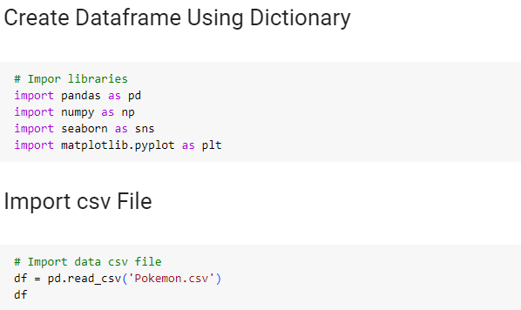
Import all libraries used

Slide 4
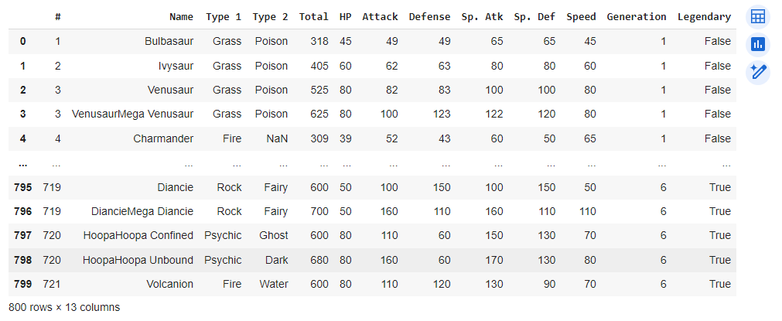
Dataset
Pokemon data can be viewed at the following link : http://bit.ly/data-pokemon-dsf
based on the table above, this dataset has 800 rows with 13 columns.

Slide 5
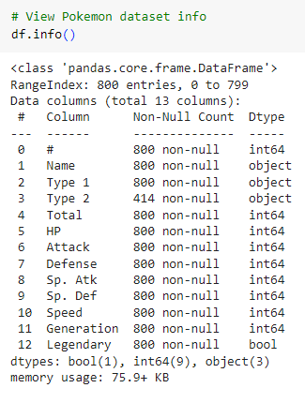
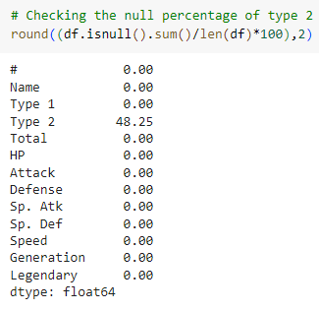
Data Understanding
In Type 2 there are 386 Null counts and after checking, the percentage is 48.25%.

Slide 6

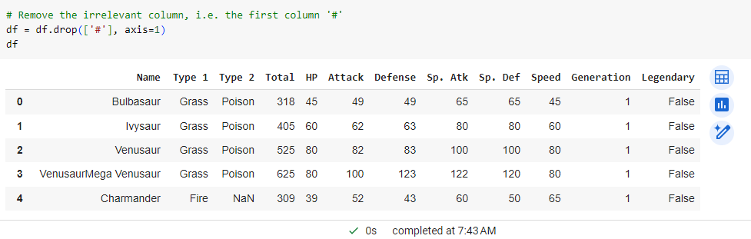

Data Cleaning
Checking for data duplication, and found no duplicate data.
Remove/delete columns that are not needed, i.e. the first column '#'

Slide 7
Pokemon data is cleaned and ready for analysis!

Slide 8
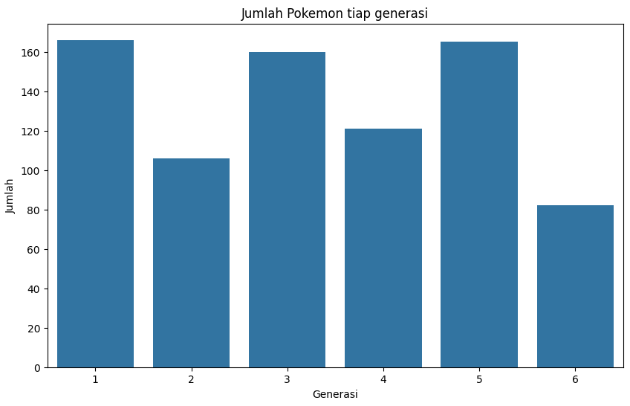
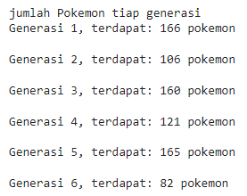
Pokemon Visualization & Calculation for Each Generation
From the graph, we can see that Generation 1 has more numbers than the following generations.

Slide 9
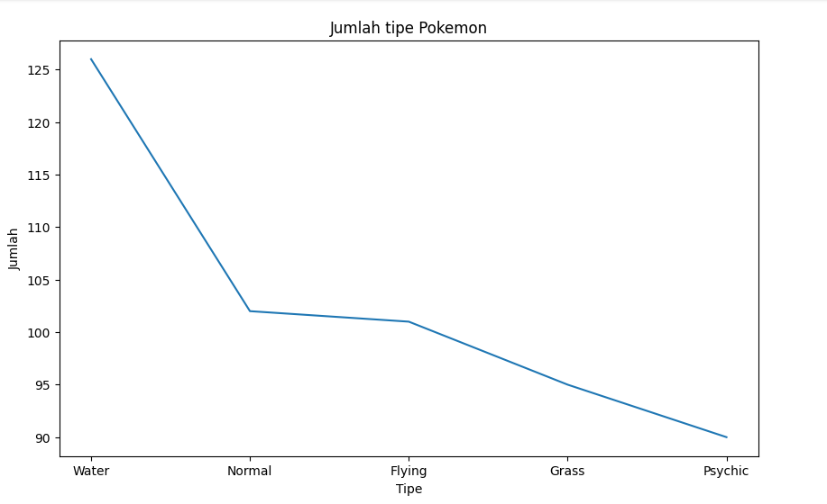
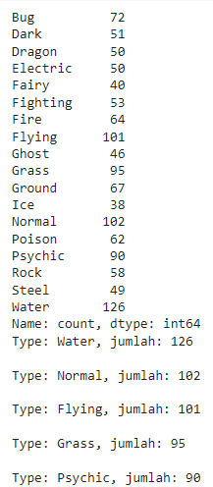
Pokemon Visualization & Calculation for Each Type
From the graph, we can see that the water type has the most number compared to the other types

Slide 10
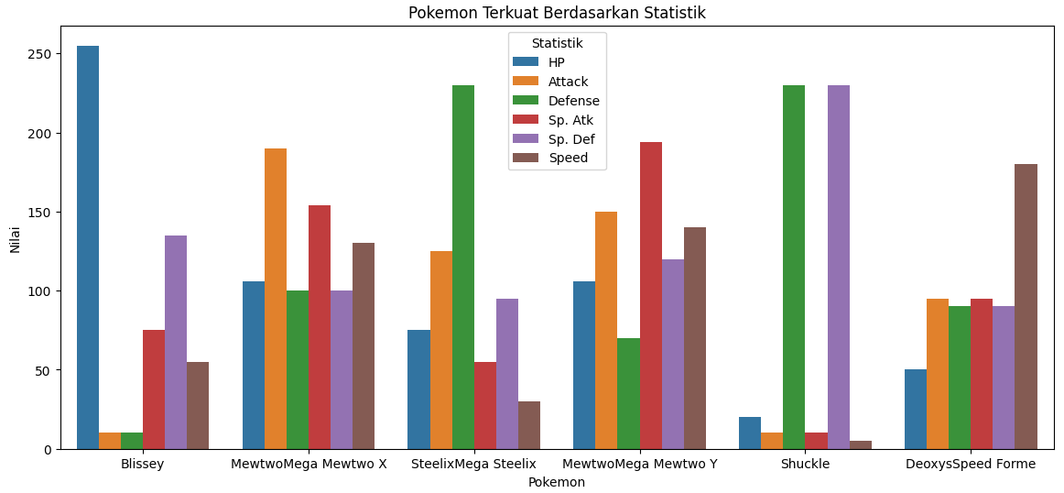
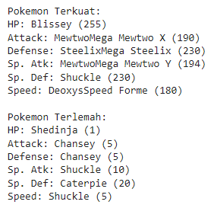
Who Are The Strongest and Weakest Pokemon Based on Each Statistic ?
From the graph, we can see a comparison of the strongest pokemon with the weakest based on statistics. For example : The pokemon with the strongest HP is Blissey while the weakest is Shuckle.

Slide 11
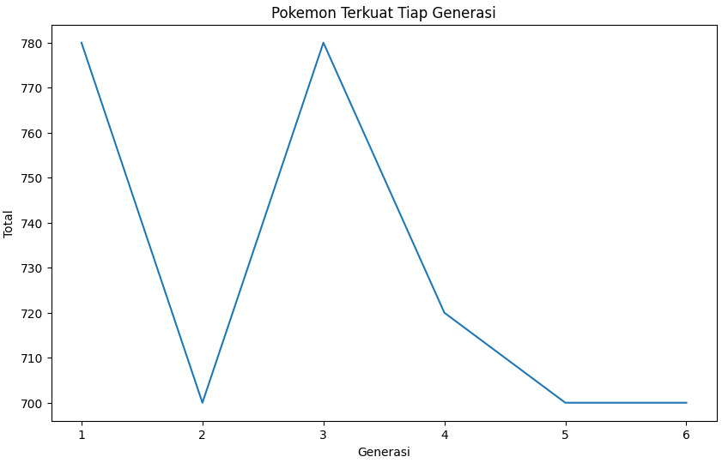


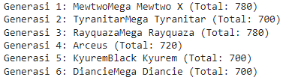
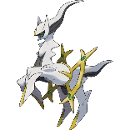
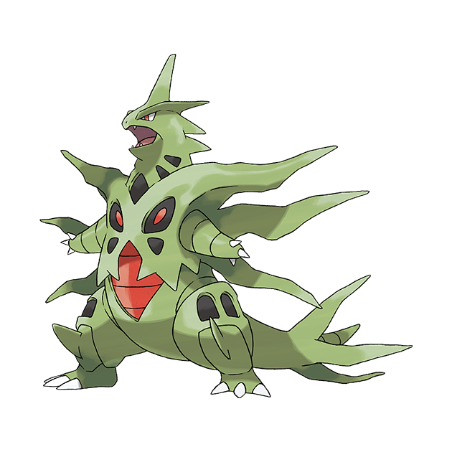


Who are the Strongest Pokemon of each generation ?
From the overall chart data, we can see that the strongest pokemon are in generation 1 and generation 3 with a total of 780

Slide 12
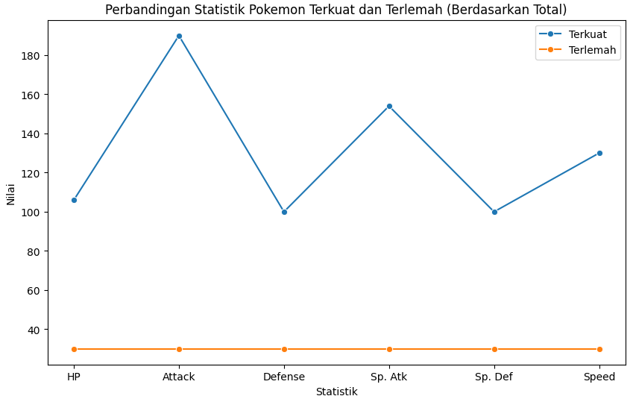
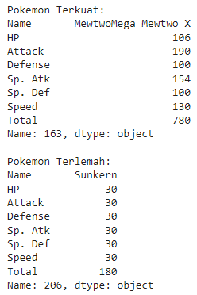

Who are the Strongest and weakest Pokemon based on their totals ?
It can be concluded that Mewtwomega Mewtwo X is the strongest among all pokemon while Sunkern is the weakest among all pokemon.

Slide 13


THANK YOU
Ammar Hidayatullah
ammarhidayatullah2@gmail.com

